Slide 1
Random Forest Regression:

Slide 2

30 Days Data Scinece & Analytics Master Class
Day1 : Python for Data Science
Time: 6.00 PM IST
Free Registration

Slide 3
30 Days Data Scinece & Analytics Master Class
Handbook

Slide 4
NANDHINI.S
Exp: 5 Yrs
Expert in
Python Developer on Machine Learning
Deep learning with computer vision
Matlab – Image Processing
Autonomous Car design using ROS with LIDAR
Language – Python , Java , HTML ,CSS.
Tools – ANACONDA NAVIGATOR, JUPYTER NOTEBOOK,
GOOGLE COLAB.
Graduation : BE – ECE | 2011

Slide 5
Pantech?
Educational Equipment Manufacturer
IoT, AI, Robotics,Autonomous Robot
Microprocessor/Microcontroller
DSP,VLSI, Embedded System
Power Electronics & Drives, Fuel Cell Trainer Kit
Renewable Energy Lab, Electric Vehicle Lab
Technical Training
DIY Project

Slide 6

What is Master Class ?
👍 This is the 30 Days Industrial Learning Activity.
👍 Its Online YouTube Live Class
👍 If you Invest 45 minutes daily, U will become Master in Data Science
👍 You will get FREE E-Certificate
Webinar Participation Certificate
“Learning is the beginning of wealth.
Searching & Learning is where the miracle process all begins.” …………….Jim Rohn

Slide 7
Our Vision
Help 10 Million Students to Learn the Technology in Easy Way

Slide 8

Associate Partner for this Master Class
https://apssdc.in/home/

Slide 9
What U will Learn from 30 Days Data Science & Analytics Master Class

Slide 10





Data Science & Analytics Learning Plan
01
02
03
04
05
Library
Python
Analytics
Tools
Industry Project
Introduction To Python and Python Data Structures
Pandas
Numpy
MatplotLib
Cborn, SKLearn Lib
Collab
Distribution
Visualization
Aggregation
Statistics
PowerBi
Tableo
Project Building,
DSA Jobs

Slide 11
Day wise Learning Plan
Day -1 : Python for Data Science (5 Solved end-to-end Data Science Projects in Python)
Day -2: Advanced Python Programming
Day -3: Pandas Library – Introduction
Day -4: Pandas Library – Data Structures
Day -5: Numpy library – Array Operations | Mathematical Functions
Day -6: Numpy – Sort, Search and Counting Functions
Day -7: Matplotlib , Histogram Using Matplotlib | I/O With Numpy
Day -8: Matplotlib Library – Introduction , Pyplot API | Types Of Plots
Day -9: Seaborn Library
Day -10: SKLearn Library
Day -11: Google Colab Notebook
Day -12: Python – Date and Time, Data Wrangling
Day -13: Python – Data Aggregation
Day -14: Python – Word Tokenization , Stemming and Lammetization
Day -15: Python – Data Visualization

Slide 12
Day wise Learning Plan
Day -16: Python – Statistical Analysis
Day -17: Python – Types Of Distribution
Day -18: Python – Correlation ,Chi-Square Test , Linear Regression
Day -19: Tableau – Introduction and Tools
Day -20: Tableau – Data Sources , Worksheets
Day -21: Spatial Data Science For Covid-19 Disease Prediction
Day -22: Power-BI – Introduction, Installation Steps and Architecture
Day -23: Power-BI – Data Modelling , Visualization Options | Excel Integration
Day -24: Parkinson’s Disease Prediction – XG Boost Classifier
Day -25: House Price Prediction using Random Forest Regression
Day -26: Customer Segmentation Using ML – K-Means Clustering
Day -27: Home Loan Prediction using Decision Tree Classifier
Day -28: Spam Classification using NLP
Day -29: Hand Written Digit Recognition Using CNN
Day -30: Churn Prediction using Deep Learning

Slide 13
List of Projects for Demo in YouTube Live
Spatial Data Science For Covid-19 Disease Prediction
Parkinson’s Disease Prediction-XGBoost Classifier
House Price Prediction-Random Forest Regression
Customer Segmentation Using ML-K-Means Clustering
Home Loan Prediction-Decision Tree Classifier
Spam Classification-NLP
Hand Written Digit Recognition Using Python-CNN
Churn Prediction-Deep Learning
Crop Yield Prediction
Ground water level prediction
All Projects in Jupyter Notebook

Slide 14
What you will get from this Free 30 Days Master Class?
You can attend YouTube Live Class
Free E-Certificate ( WEBINAR PARTICIPATION CERTIFICATE)

Slide 15
How to mark your Attendance in YouTube Live Class?
Ans : During the Live Class, organizer will post Google Form link in Live Chat. The Participants should submit the from on daily basis. Minimum 25 Days Attendance is Required to get Free Master Class Participation Certificate.
Note : The Link will be available during the Live. From the LIVE Class date, the live video will get removed from the YouTube in 3 days.

Slide 16
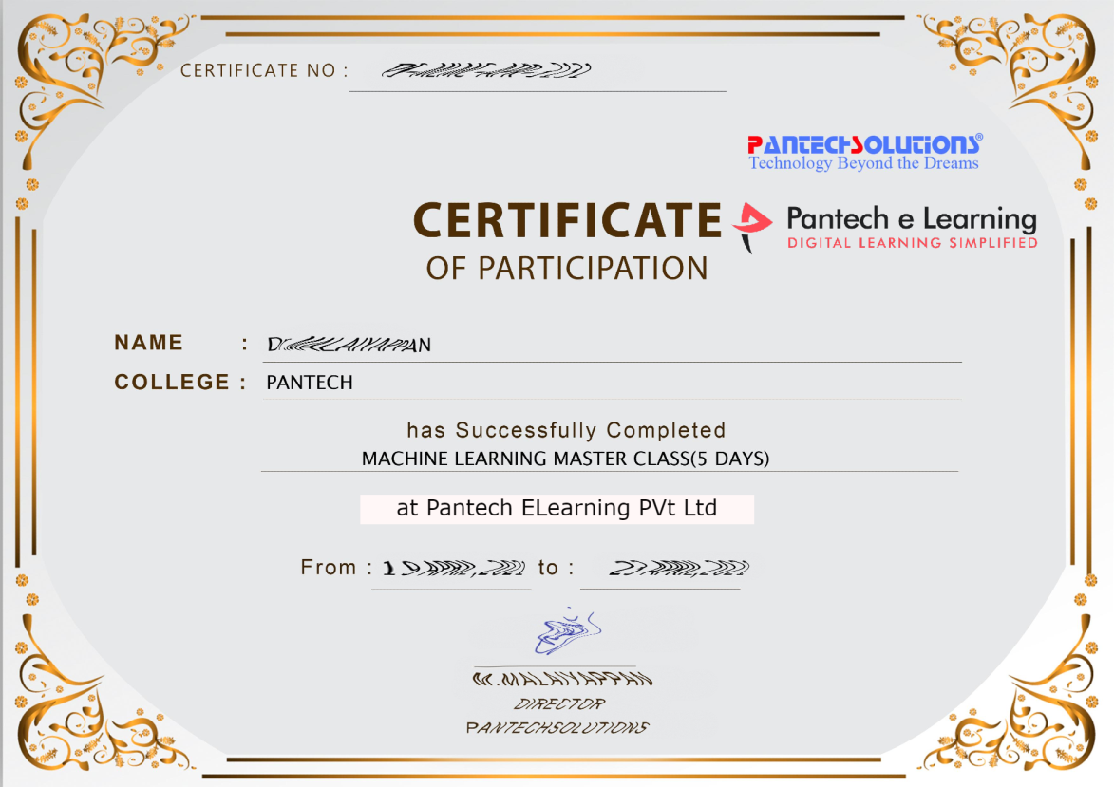

Sample Webinar Participation Certificate?

Slide 17
https://www.pantechelearning.com/data-science-master-class/
On Demand
You can get chance to apply 1 Month Internship on Data Science & Analytics Master Class

Slide 18
What is Internship????
Learn
Practice
Verify
Get Certified
Grow

Slide 19
Free Master Class DSA | 1 Month Internship on DSA
Master Class Participation Certificate | Internship Completion Certificate
Minimum 25 Class should attend YouTube Live | Recorded Class Link will be provided. – LMS Portal Access
YouTube Live Mandatory | Your Choice. You can attend Live or else You can watch Recorded Class in LMS Portal
All Projects Demo class in YouTube Live | Step by Step Video Explanation Content in LMS Portal
Access : 3 Days | VIP WhatsApp Group Support
 | You Can Download All PPTs
 | 4 Nos of Hackathon Class in Zoom Live. The Recording also will be provided
 | You Can Download All Project Files
 | Mentor will guide you to finish 10 Projects
 | Access : 60 Days

Slide 20
Pantech will make you to Create 10 Projects in Data Science & Analytics in 30 Days
Objective of this 30 Days Master Class

Slide 21
1 Month Internship in Data Science
INTERNSHIP E-Certificate(30Days Internship on Data Science Engineering)
Highly organized Video content
Download All Files
Download PPTs
Assignments
Flexible Time.
Access Period: 60Days from the date of payment

Slide 22
What You Will Get???
Complete Project Files
30 Days Learning Activity
Data Science Core Concepts
10 + Projects
Project PPT
Spatial Data Science For Covid-19 Disease Prediction
Parkinson’s Disease Prediction-XGBoost Classifier
House Price Prediction-Random Forest Regression
Customer Segmentation Using ML-K-Means Clustering
Home Loan Prediction-Decision Tree Classifier
Spam Classification-NLP
Hand Written Digit Recognition Using Python-CNN
Churn Prediction-Deep Learning
Crop Yield Prediction
Ground water level prediction
Video Class Access for 2 Months
Get chance to Enroll 1-Month Internship on demand

Slide 23

How to join in 1 month Internship
https://www.pantechelearning.com/data-science-master-class/
Click Here
Coupon Code: DSABATCH4

Slide 24


Slide 25
Random Forest Regression:
Random Forest Regression algorithm is a strong algorithm when compared to other types of regression techniques.
A linear regression algorithm is denoted by a function y = mx + c .
A Random Forest algorithm cannot be represented by those simple functions.
They produce better results when compared to other types of algorithms .
They are suitable for large datasets.
They work with missing data by creating estimates for them.
The major threat posed by random forest regression is that they can’t work beyond the normal range of data.

Slide 26
Random Forest Regression:
A Random Forest Algorithm is nothing but a collection of decision trees.
Many trees are grouped together in a random way in order to create a Random Forest.
Every tree is constructed from a different sample of rows.
At each node , a different set of features is selected for splitting.
Each and every tree makes its own independent prediction.
All theses results are summarized in order to produce the final result.

Slide 27
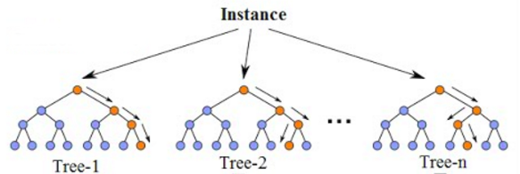
Random Forest Regression:

Slide 28
Random Forest Regression:
Averaging process makes the Random Forest Algorithm a better algorithm when compared to other types of algorithms.
Averaging process improves the accuracy and reduces overfitting.
It is an average of predictions produced by all the trees in the forest.
The trees protect each other from their individual errrors.
It averages the result of many regression trees and produces the most optimal result.

Slide 29
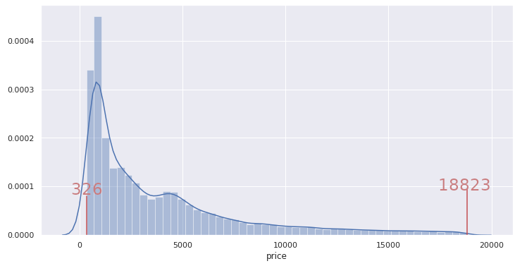
Random Forest Regression Example:
Let’s take a simple example and try to apply Random Forest Regression algorithm and find the prediction result.
We want to predict the price of diamonds based on some features like carat , depth , table etc.

Slide 30
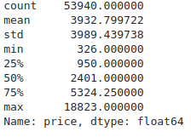
Random Forest Regression Example:

Slide 31
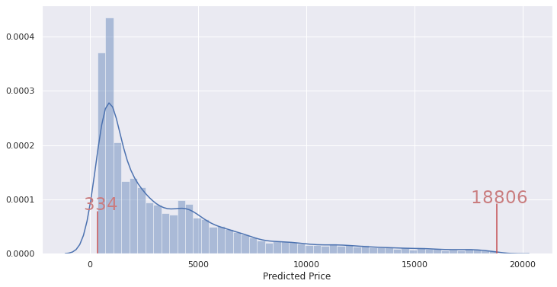
Random Forest Regression Example:
Random Forest Regression algorithm can be applied on the dataset in order to obtain the desired results.

Slide 32
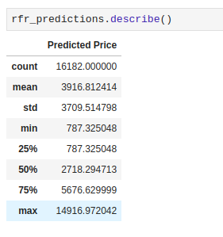
Random Forest Regression Example:

Slide 33
Random Forest Regression Example:
The values lies within the range of 326 and 18823.
The values that are there in the training set.
If any values lies outside this range , Random Forest algorithm cannot predict those values.
It cannot extrapolate.

Slide 34
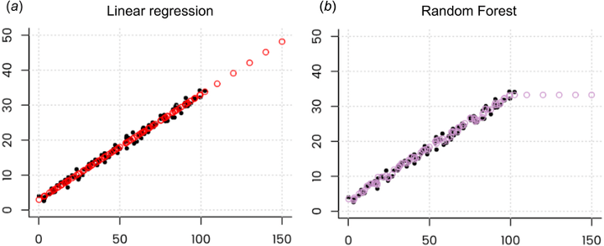
Extrapolation Problem:
When we use Random Forest Regressor , the predicted values should never lie outside the range of training set values for the target variable.
The following is a graph of Random Forest Regressor:

Slide 35
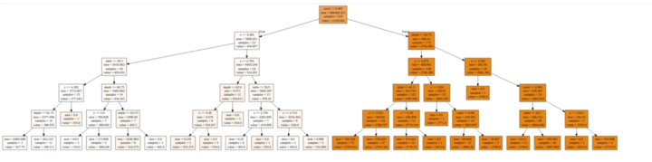
Extrapolation Problem:
The dataset used in the above table has the features like carat , depth , table , x, y and z for price prediction.
The following diagram is an example of a Decision tree from the Random Forest Regressor.

Slide 36
Extrapolation Problem:
The problem is split into smaller parts and then we are going to analyze the problem.
There are four samples with depth <=62.75, x<=5.545, carat <= 0.905 and z<= 3.915.
The price being predicted for these is 2775.
The figure denotes the average of all these four samples.
Any value in the test set that falls in the leaf will be predicted as 2775.75.

Slide 37
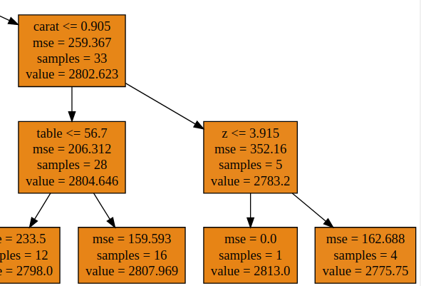
Extrapolation Problem:

Slide 38
Extrapolation Problem:
When Random Forest Regressor need to predict some values that is not previously seen , then it takes the average of all the previous values.
The average of a sample does not fall outside the highest and the lowest values in the sample.
This algorithm cannot find the hidden trends that would help the algorithm in extrapolating values that lie outside the training set.
When faced with such a situation , regressor assumes that the prediction will fall close to the maximum value in the training set.

Slide 39
Solutions:
There are few options in order to deal with the extrapolation problem.
Instead of Random Forest Regression , we can use other regression models like SVM Regression , Linear Regression , etc.
Deep learning models can be built because they are able to deal with the extrapolation problem.
The results of predictors can be combined using various stacking techniques.
A stacking regressor can be created using a Linear model and a Random Forest Regressor.

Slide 40
Solutions:
Based on the problem , some of the enhanced or modified versions of Random Forest Algorithm can be used.
One of the extensions of Random Forest Algorithm is the Regression Enhanced Random Forest Algorithm(RERFs).
The authors of this paper use a technique of penalized parametric regression in order to
Achieve better results in extrapolation problems.

Slide 41
Solutions:
There are two steps to the process:
Run Lasso before Random Forest.
Train a Random Forest on the residuals from Lasso.

Slide 42
Solutions:
Random Forest algorithm is a fully nonparametric predictive algorithm.
It does not efficiently incorporate relationships between the response and the predictors.
The response values are the observed values Y1, ……….. Yn from the training data.
They are able to incorporate known relationships between the response and the predictors.
It is one of the major benefits of using Regression enhanced Random Forests for regression problems.

Slide 43
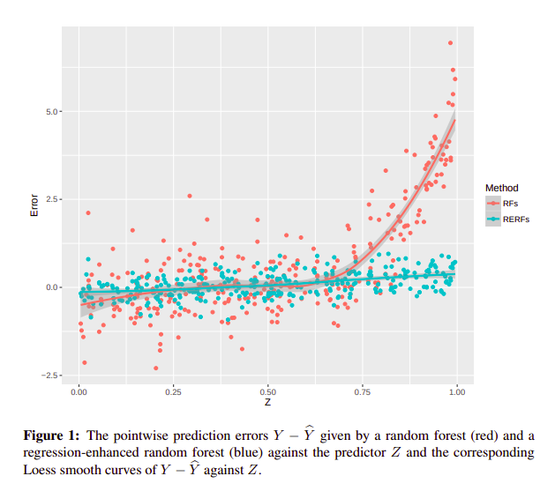
Regression Enhanced Random Forests:

Slide 44
Advantages:
When the data has a non-linear trend , we can go for Random Forest Regression algorithm.
When the extrapolation outside the training data is not important , we can go for Random Forest Regression Algorithm.

Slide 45
Disadvantages:
This algorithm cannot be used when the data is in a Time series form.
Every Time series problem require identification of a growing or decreasing trend that a Random Forest Regressor will not be able to formulate.

